Slide 1
Artificial Intelligence
Korea Institute of Energy Technology
Geun Ho Gu
2024-02-25

Slide 2






Artificial Intelligence is everywhere

Slide 3
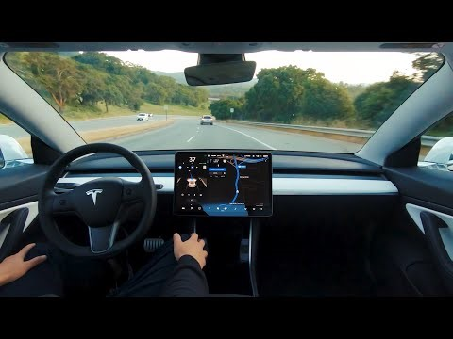
Tesla self driving

Slide 4
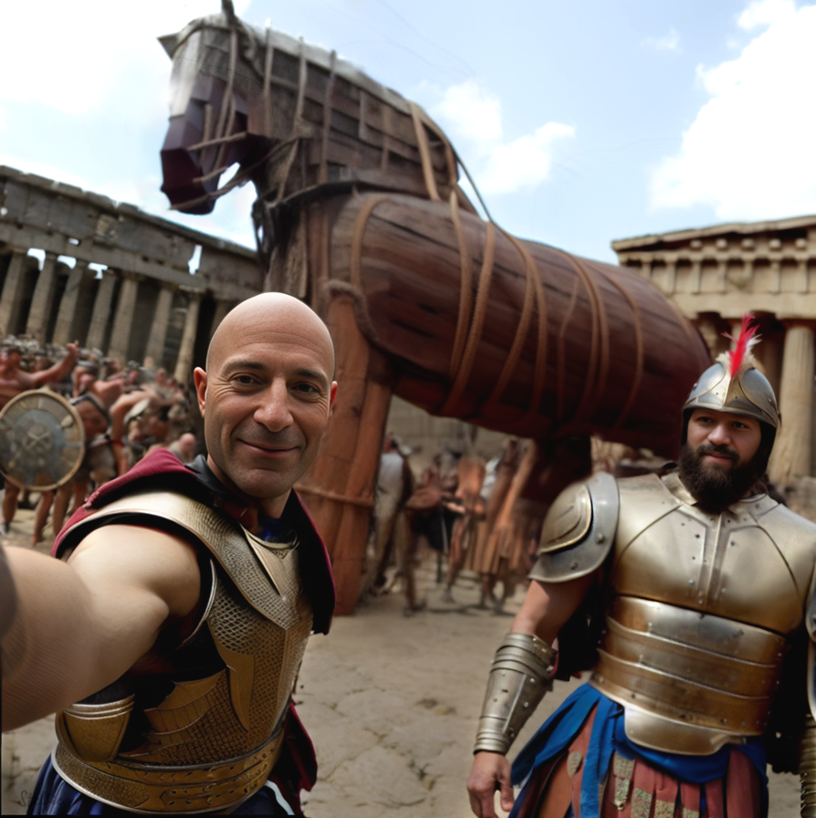
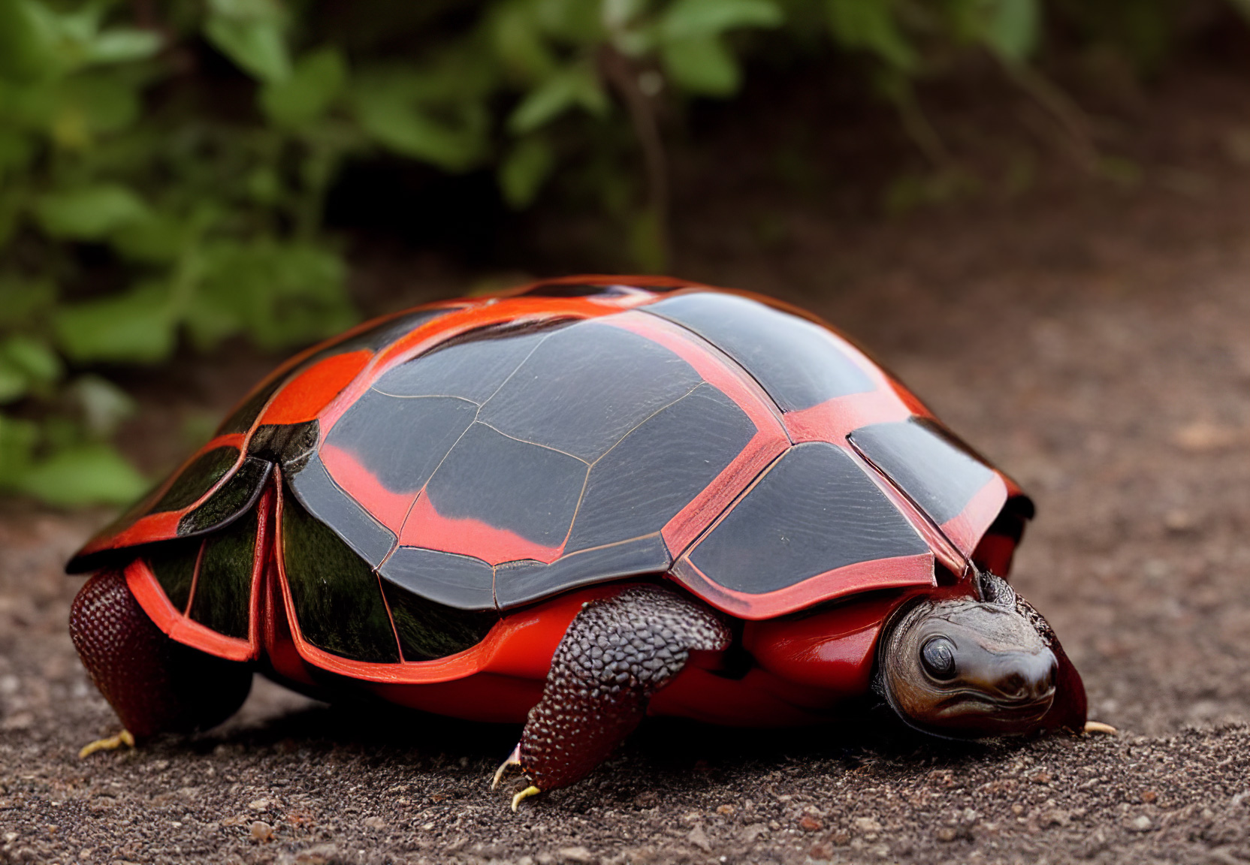
Stable Diffusion
Ulysses and the Trojan Horse Selfie
Turtle Bug

Slide 5
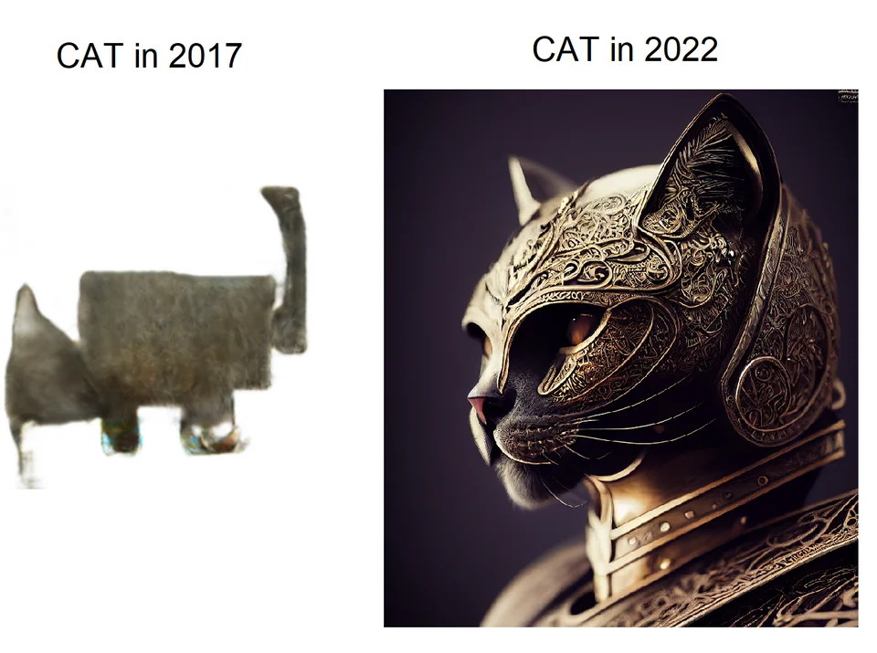

Stable Diffusion
Knight cat
rainy neon cyberpunk mega city, scyscraper, cars, people

Slide 6
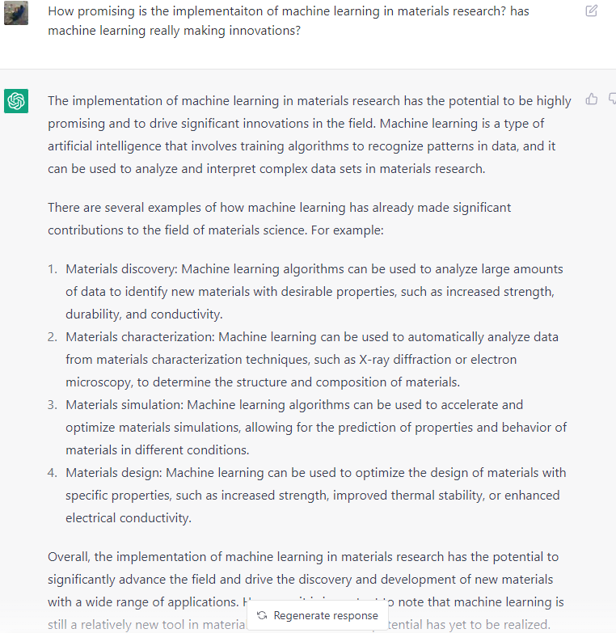
ChatGPT

Slide 7
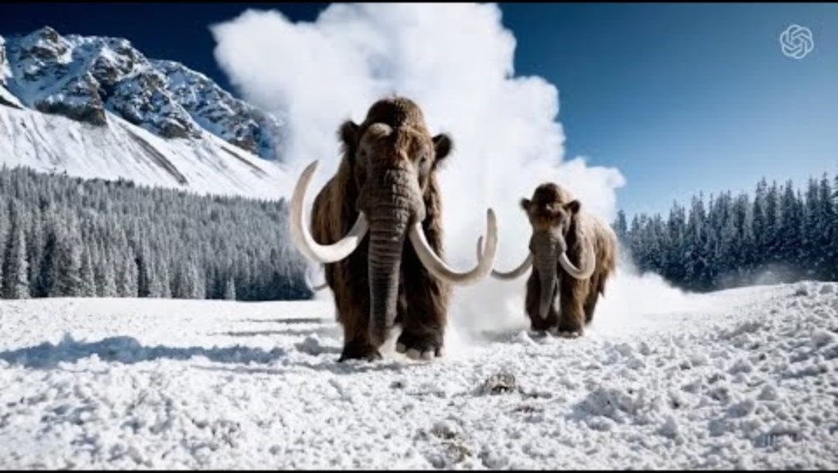
OpenAI Sora 2/18/2024

Slide 8
Digital Chemistry

Slide 9
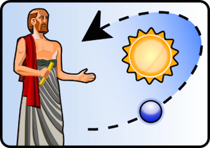
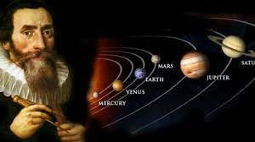
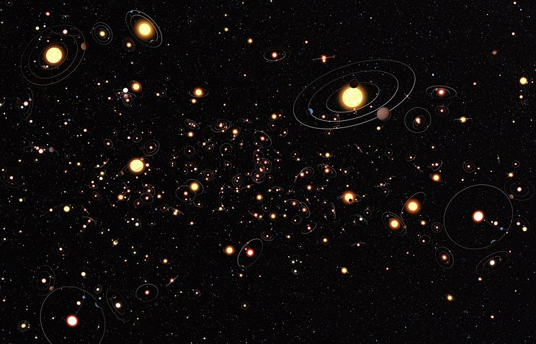

Evolution of Science
Observation
Rules
Aristarchus
Kepler
Data Science
Theory
Discovery of new planets from planets’ motion
Isaac Newton

Slide 10
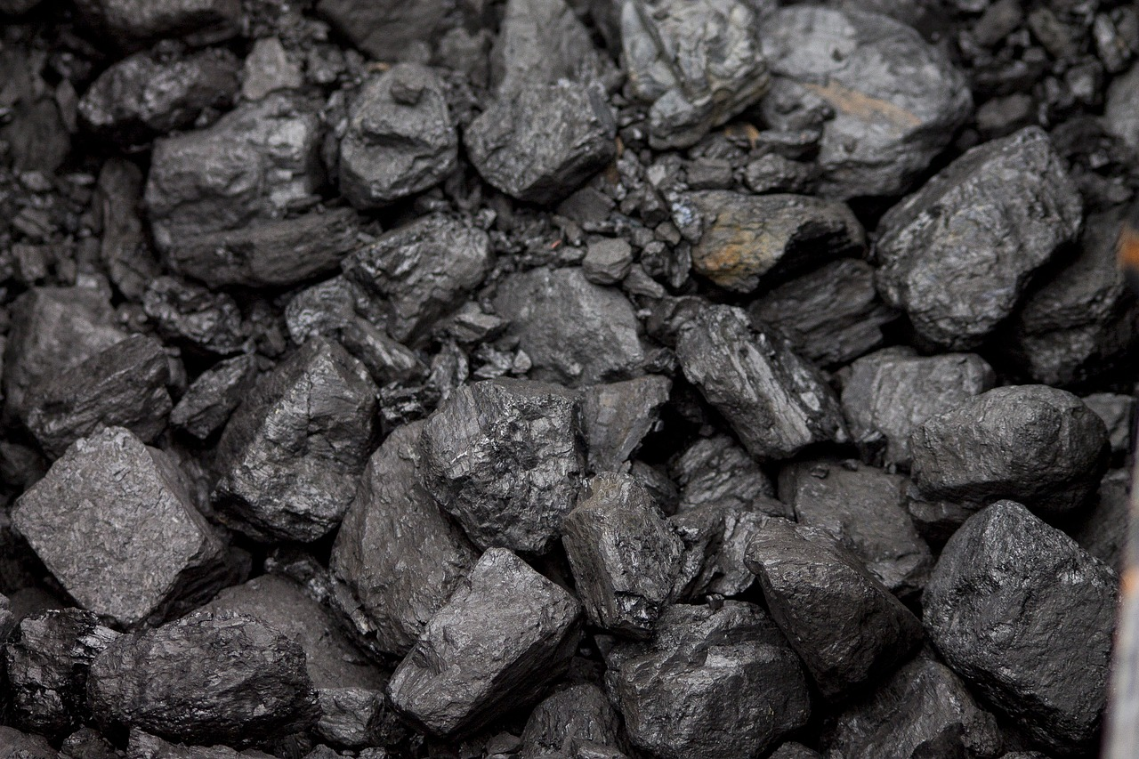
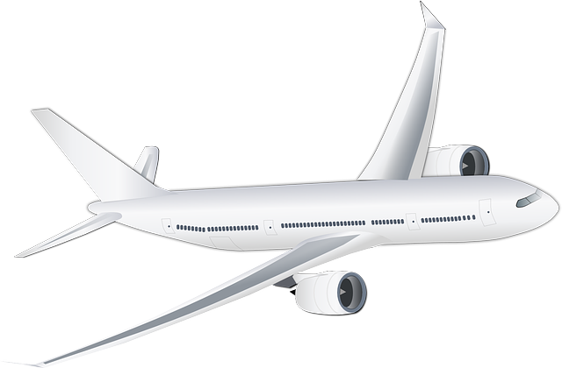
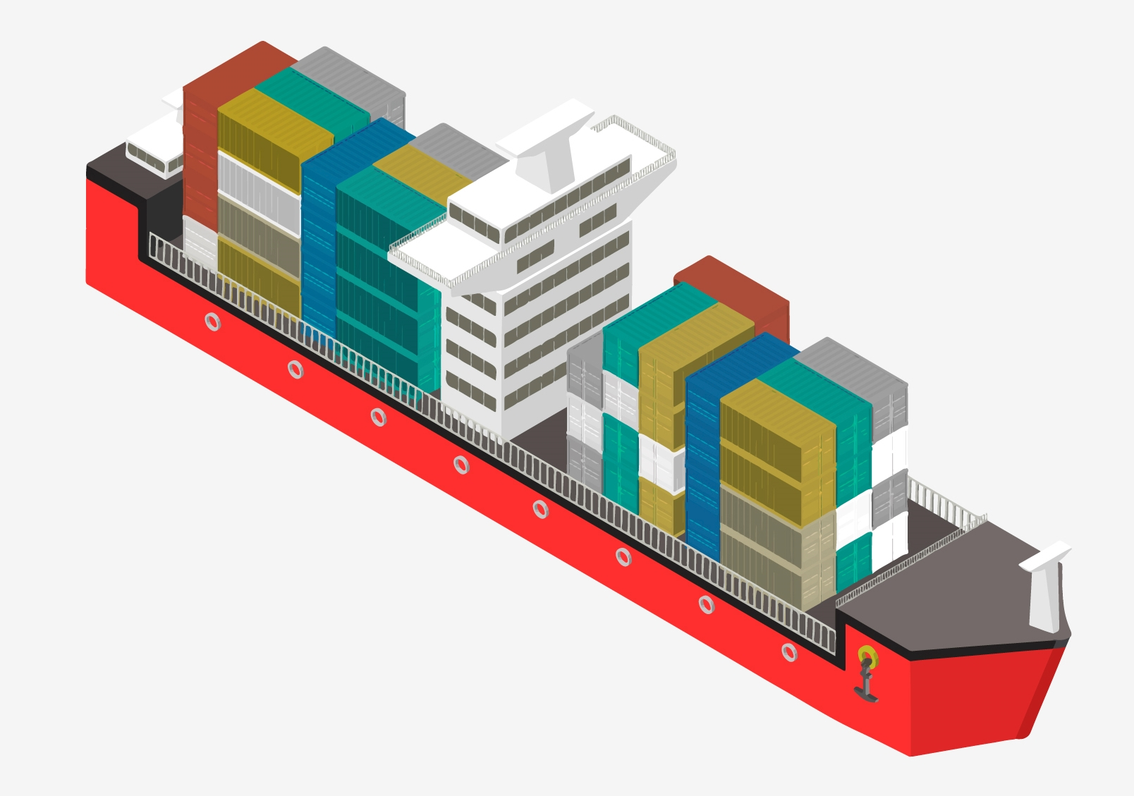


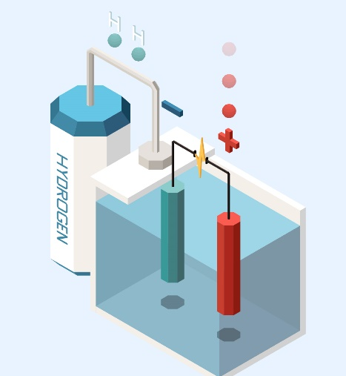
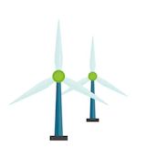
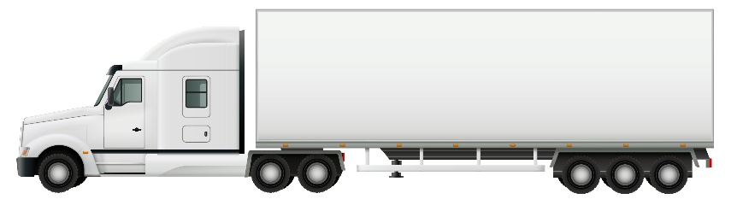

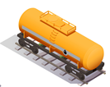


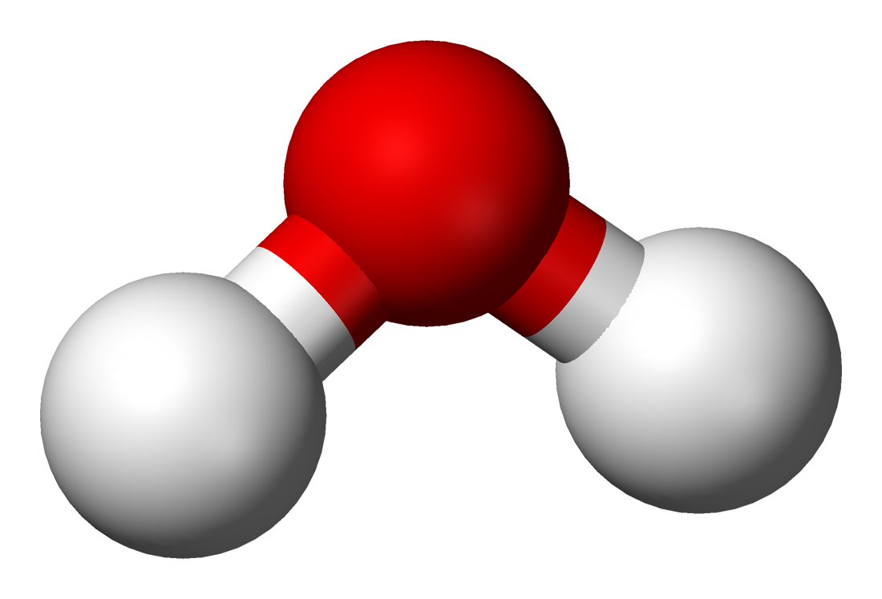
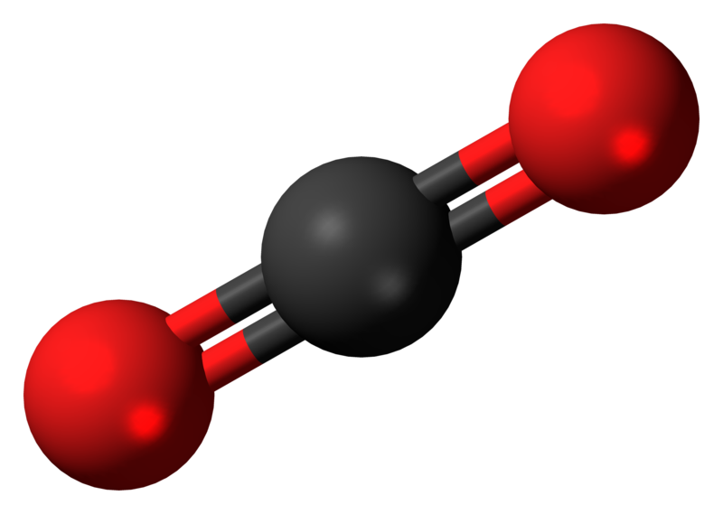
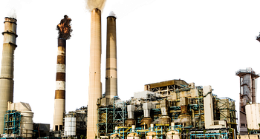
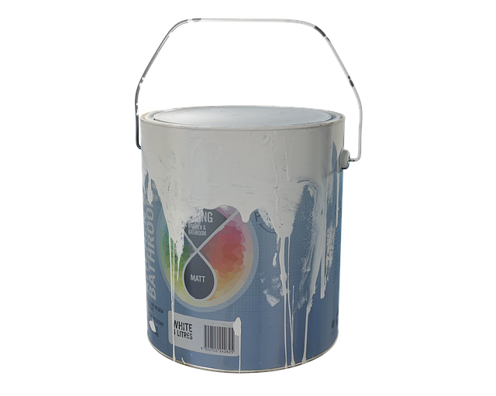
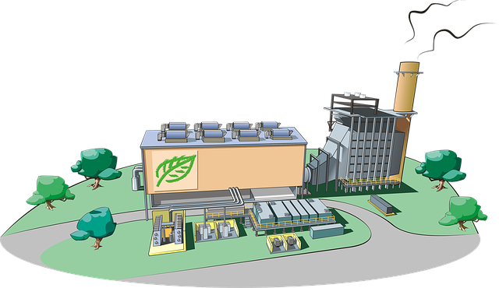
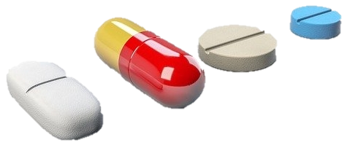


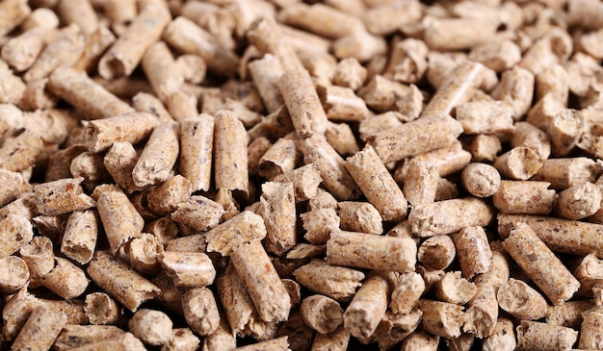
Renewable Energy Society Portfolio
Fossil industry
Renewable industry
Photoactive materials
Catalysts
Coal
Powerplant
Fuels
Solar, wind
Electrolyis plant
Natural gas
H₂O, CO₂, N₂
Refinery
Bio refinery
Oil
Plastics, Chemicals
Biomass
<lincense free images from freepik, pixabay used>
DOE, Hydrogen Production & Delivery Program, June 2017 ; Daoutidis et al. AICHE J. 2012, 59, 3

Slide 11
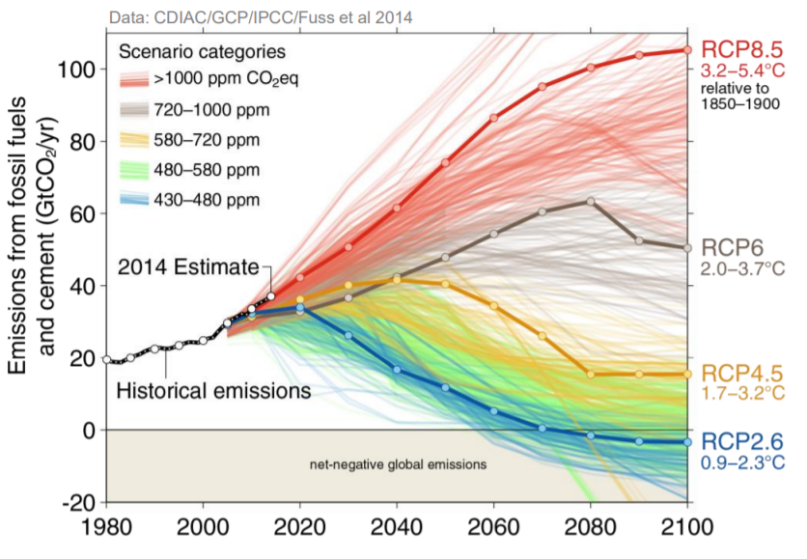
Innovation Needed to Cut Emissions
Business as usual
International target
Emission stabilization with technologies
Renewable energy
Society
2050
Moss et al. Nature, 2010, 463, 747-756; Rogelj et al. Nature, 2016, 534, 631 – 639

Slide 12
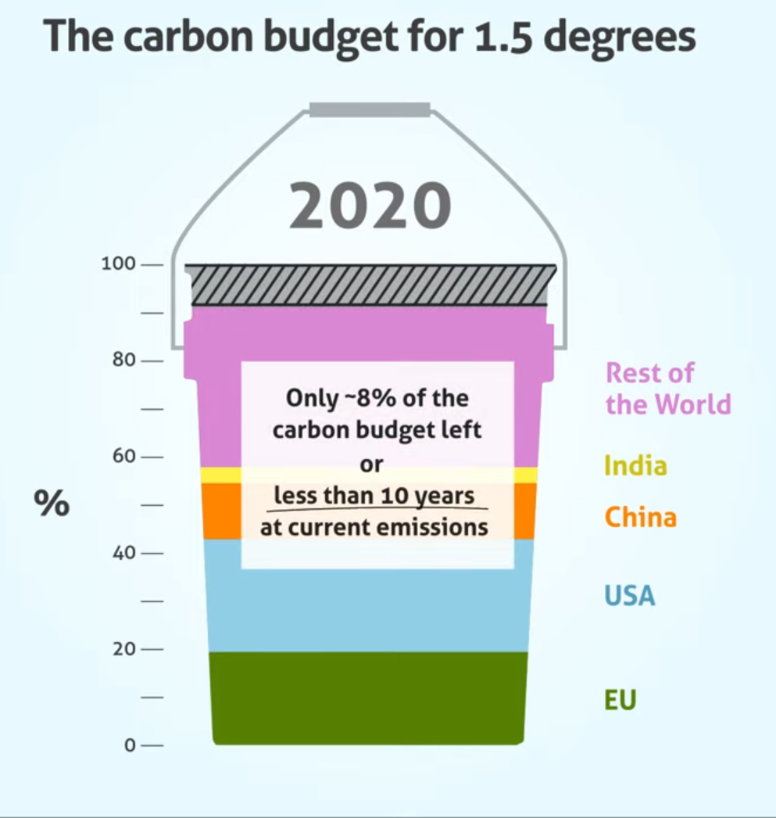
Carbon Budget and Need for Accelerated Research
Challenges
The 1.5ºC scenario carbon budget runs out in 6 years
The deployment of new technology takes 10-20 years
We need to accelerate research!
<Creative Commons Attribution License>
Rob Jackson, Alistair Scrutton, Jerker Lokrantz
Carbon budget: IPCC (Aug 2021) AR6 Climate Change 2021; Technology deployment: Nat. Rev. Mater. 2018, 3, 5

Slide 13
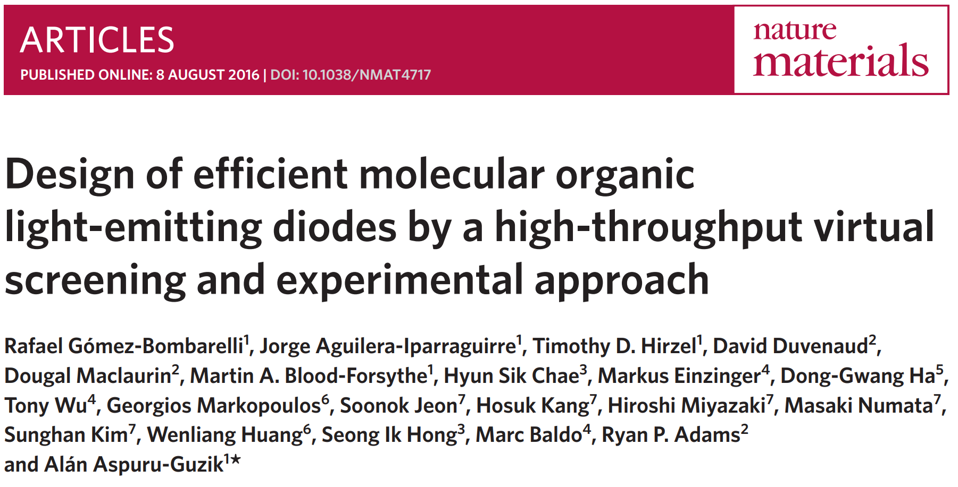

Slide 14
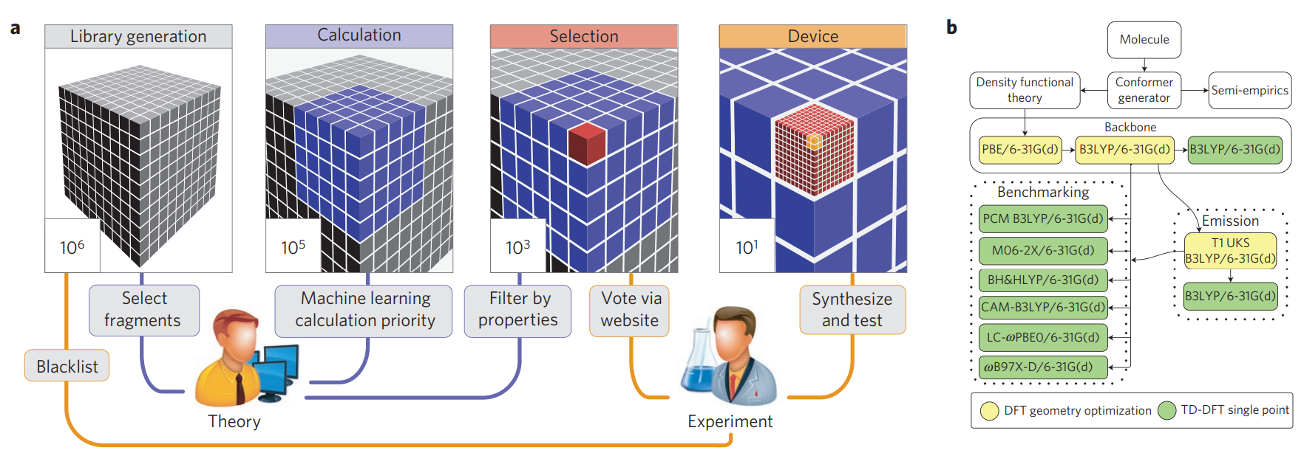

Slide 15
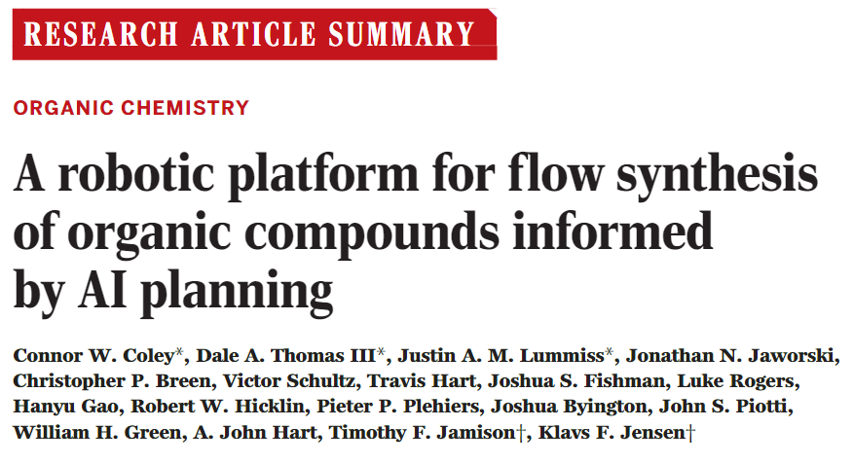

Slide 16
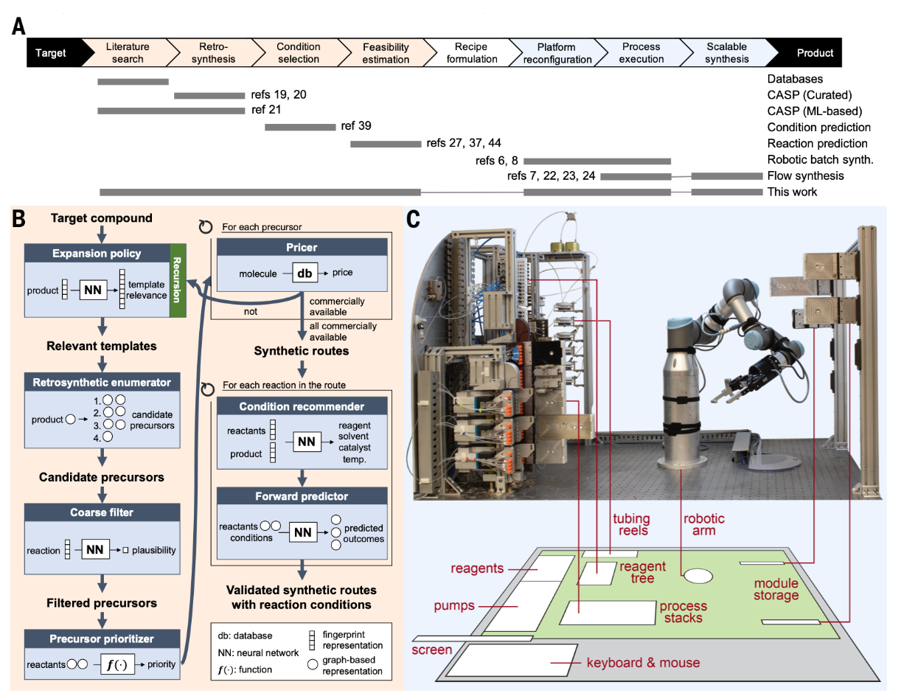

Slide 17
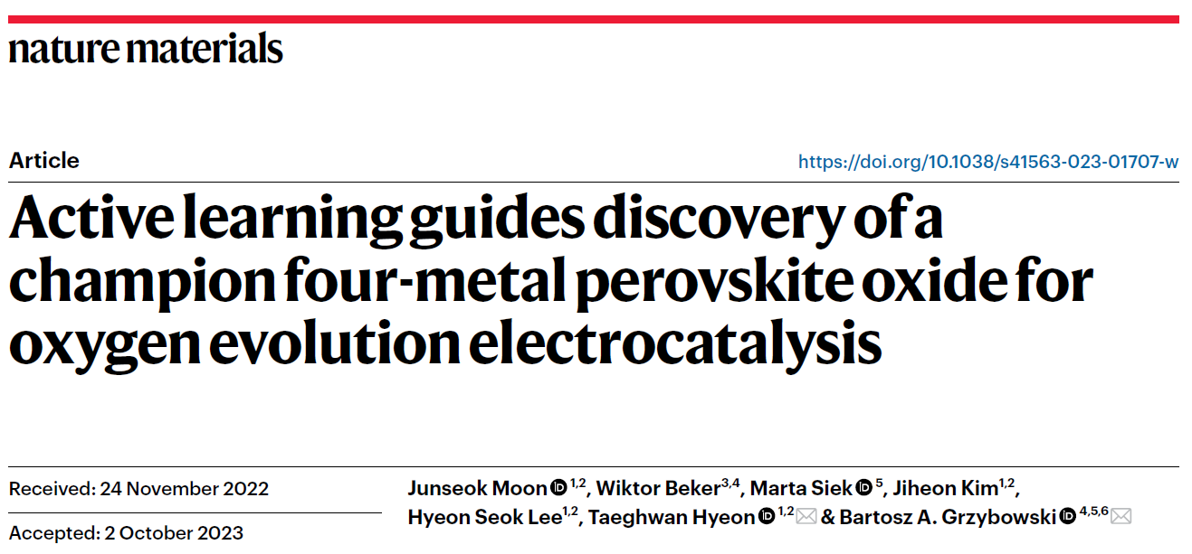

Slide 18
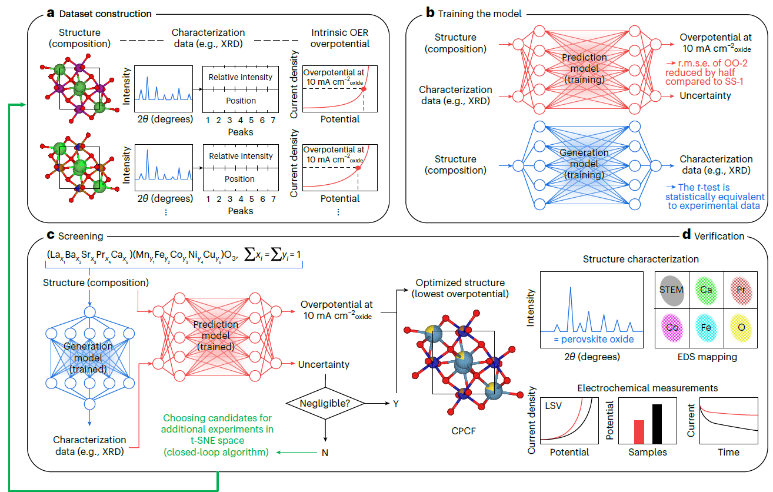
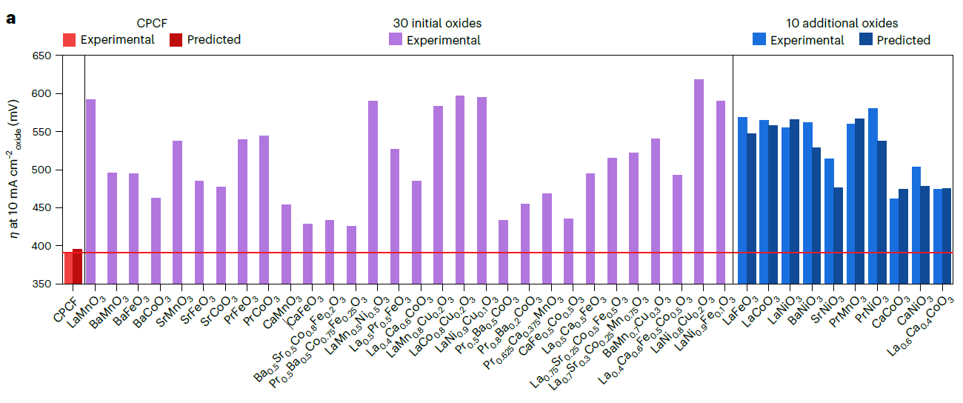

Slide 19
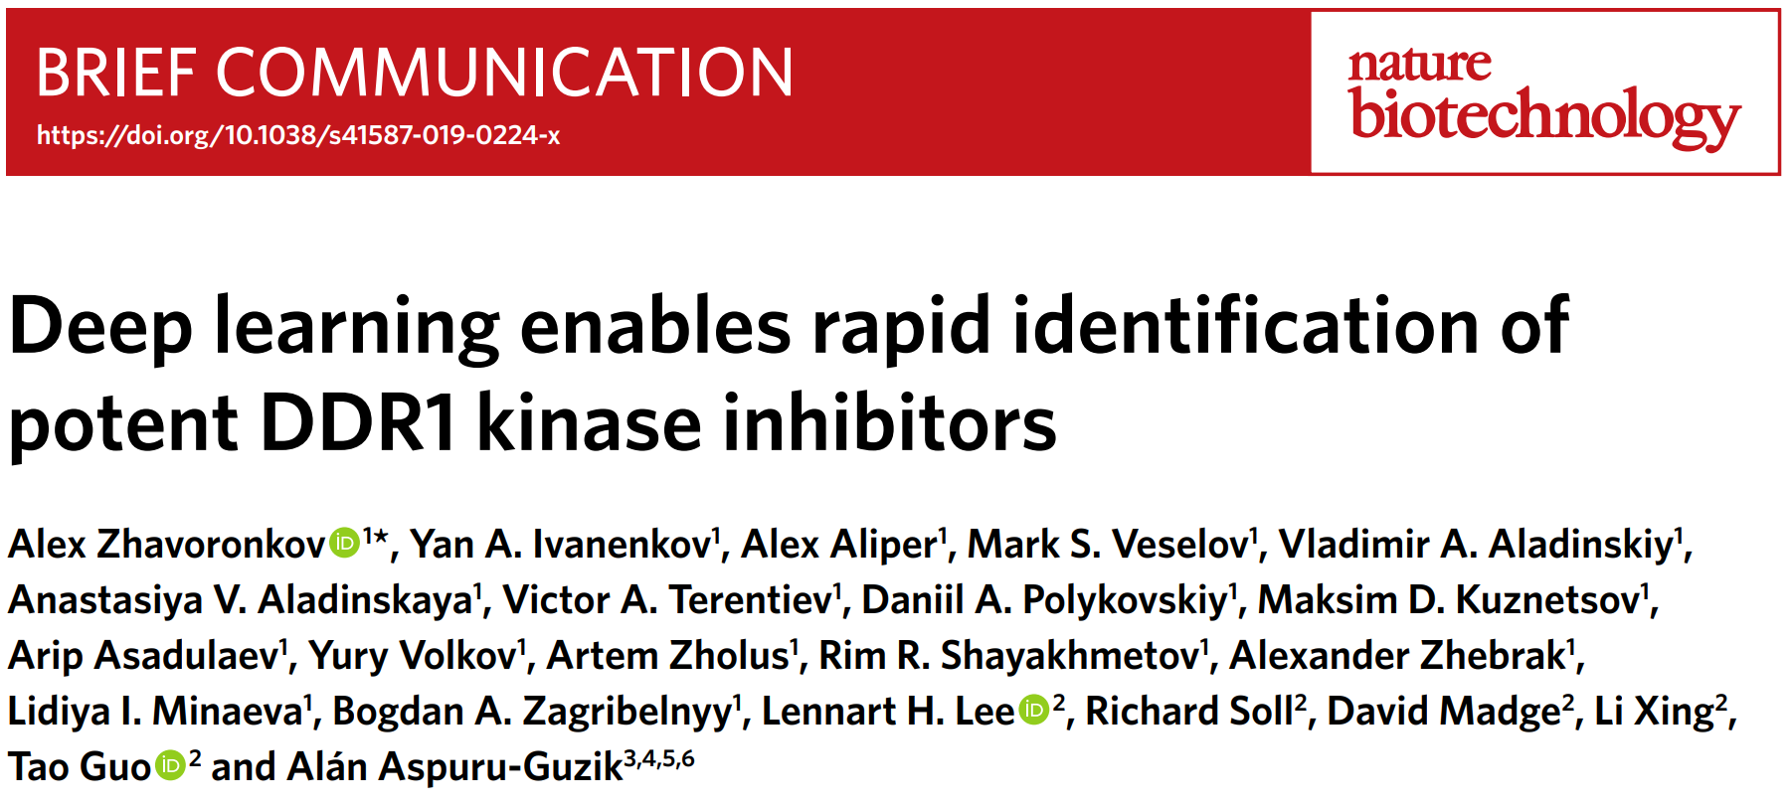

Slide 20
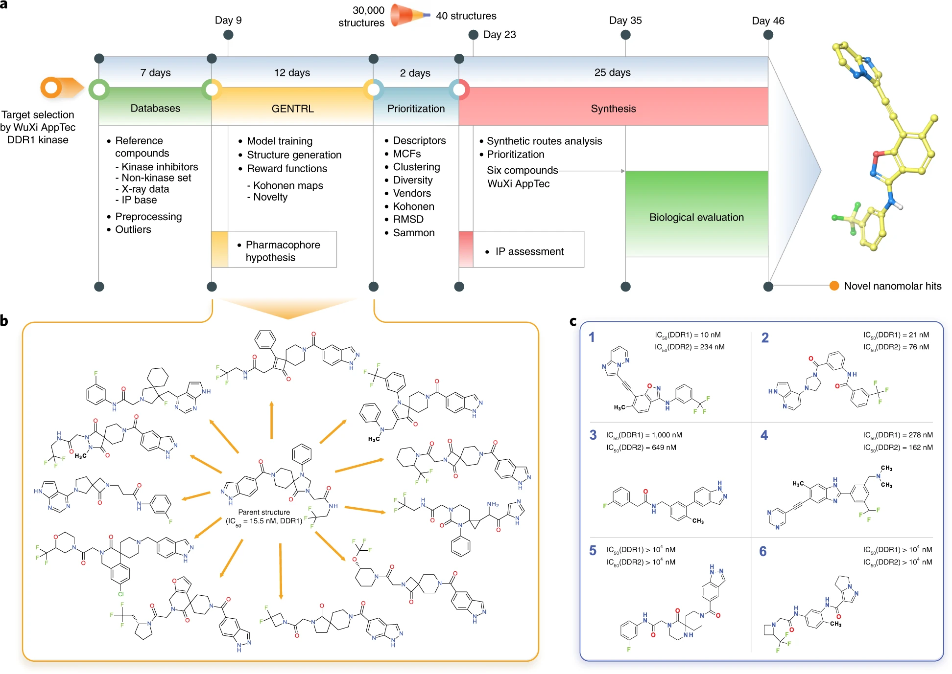

Slide 21
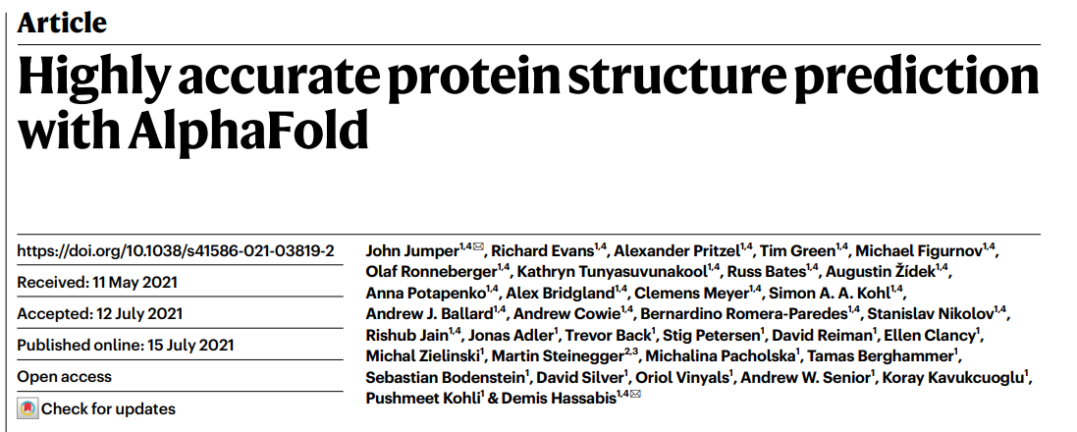

Slide 22
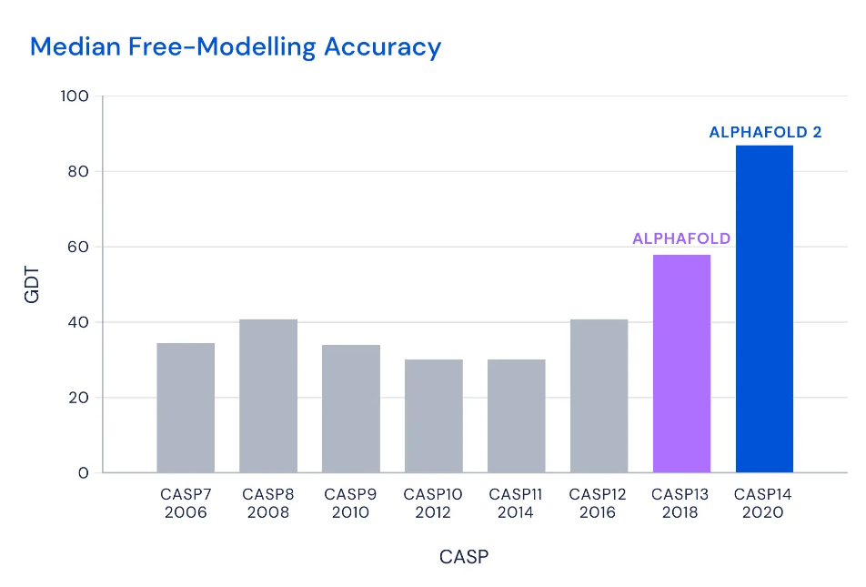
Experimental accuracy is known to be about 80%

Slide 23
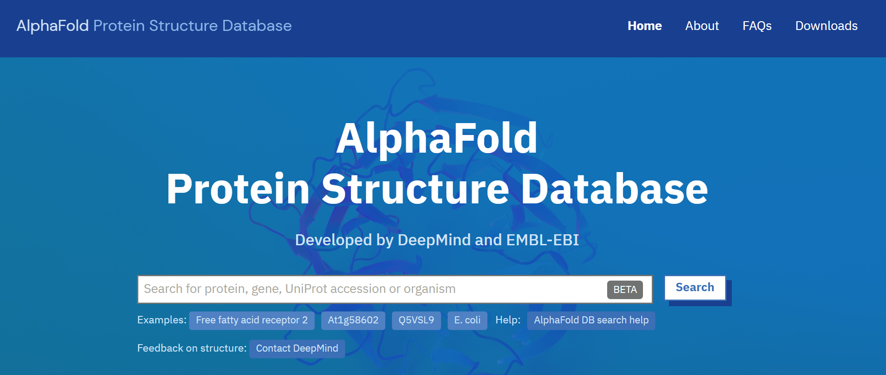
Over 350,000 protein structures, including 20,000 proteins expressed in the human body

Slide 24
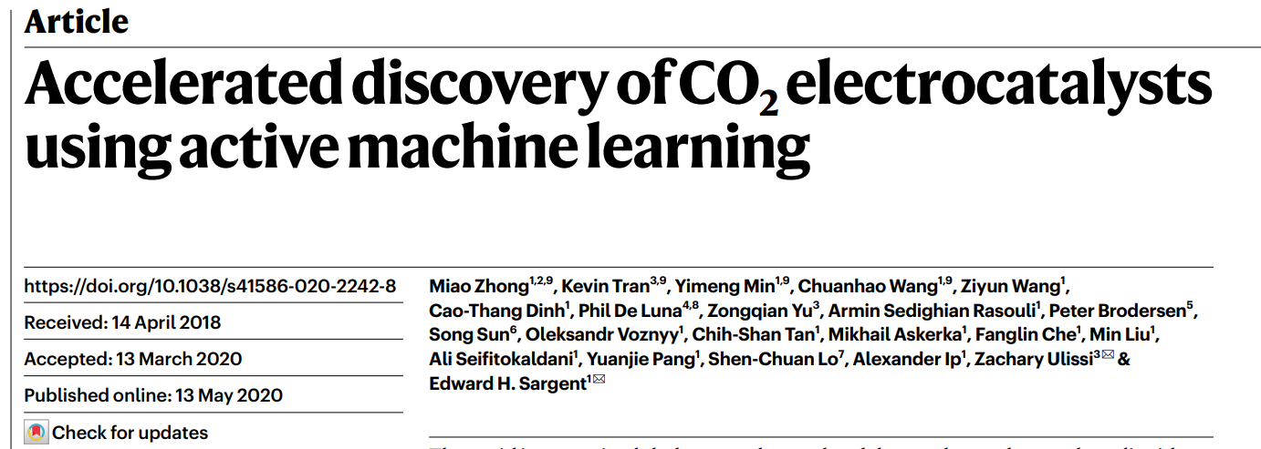

Slide 25
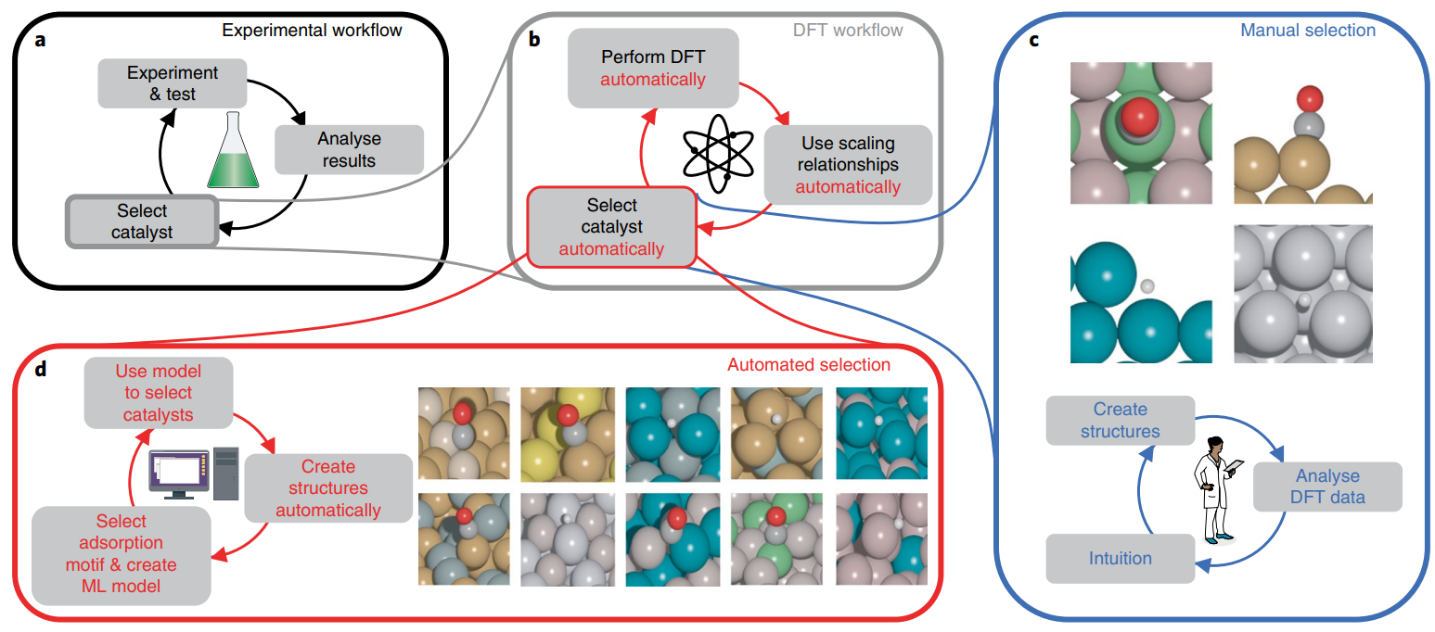
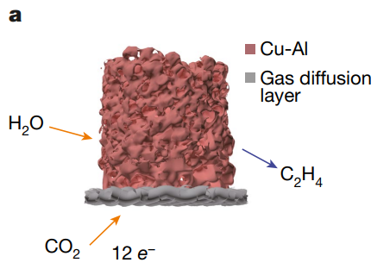
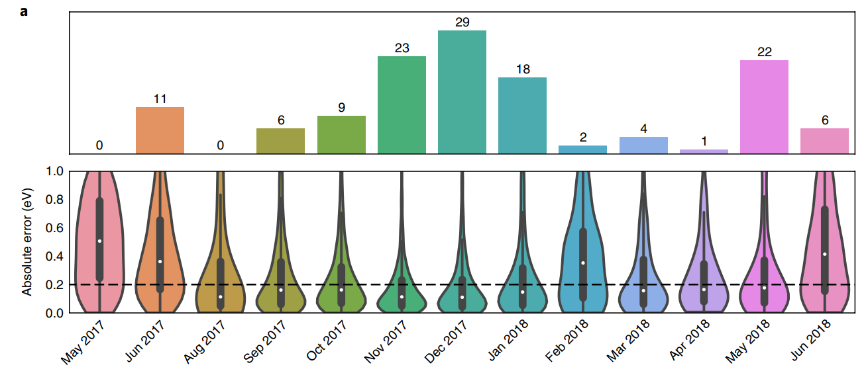
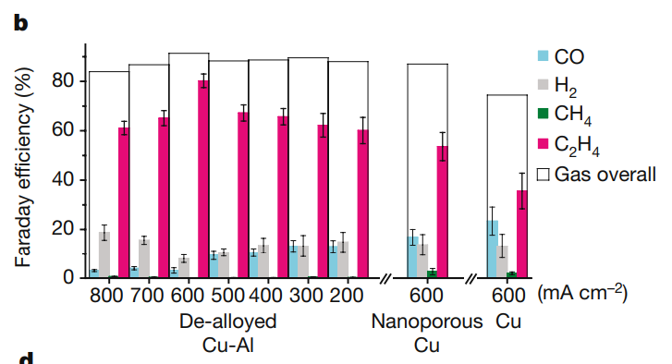

Slide 26
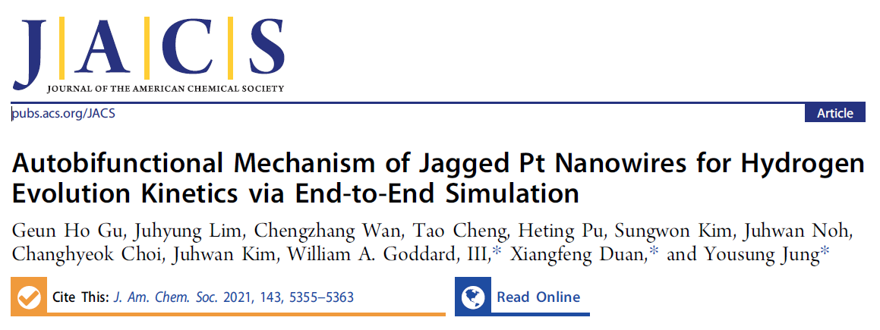

Slide 27
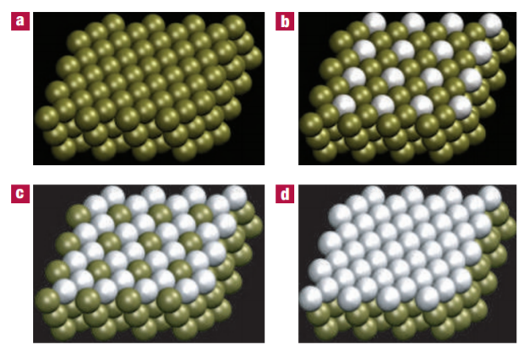
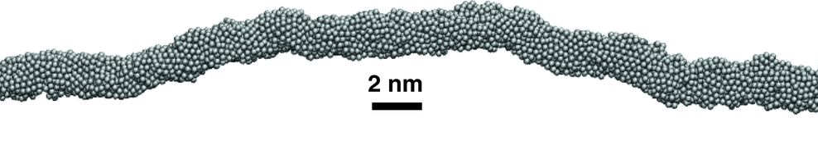

Slide 28
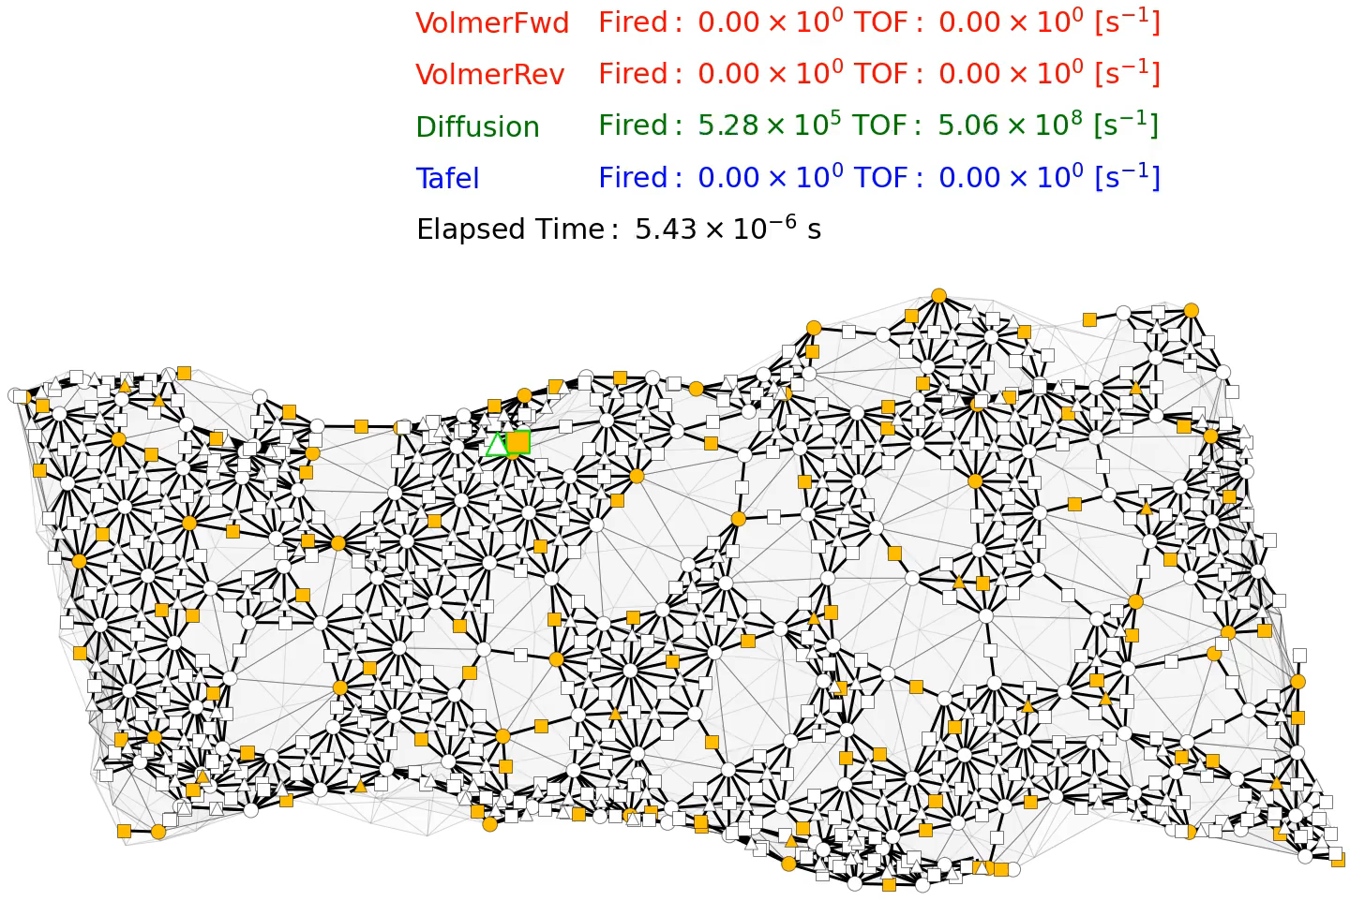
Kinetic Monte Carlo Simulation
Top site
Bridge site
Hollow site
Unoccupied
Occupied by H
H diffusion
H⁺ adsorption
H₂ gas formation
Gu et al. J. Am. Chem. Soc. 2021, 143, 5355

Slide 29
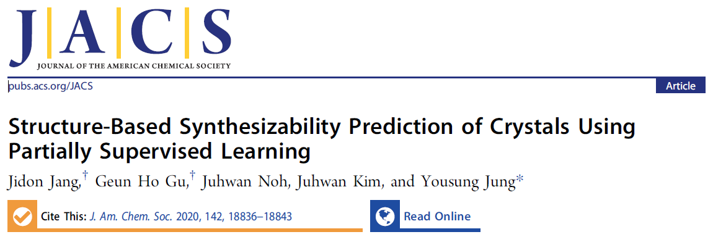

Slide 30
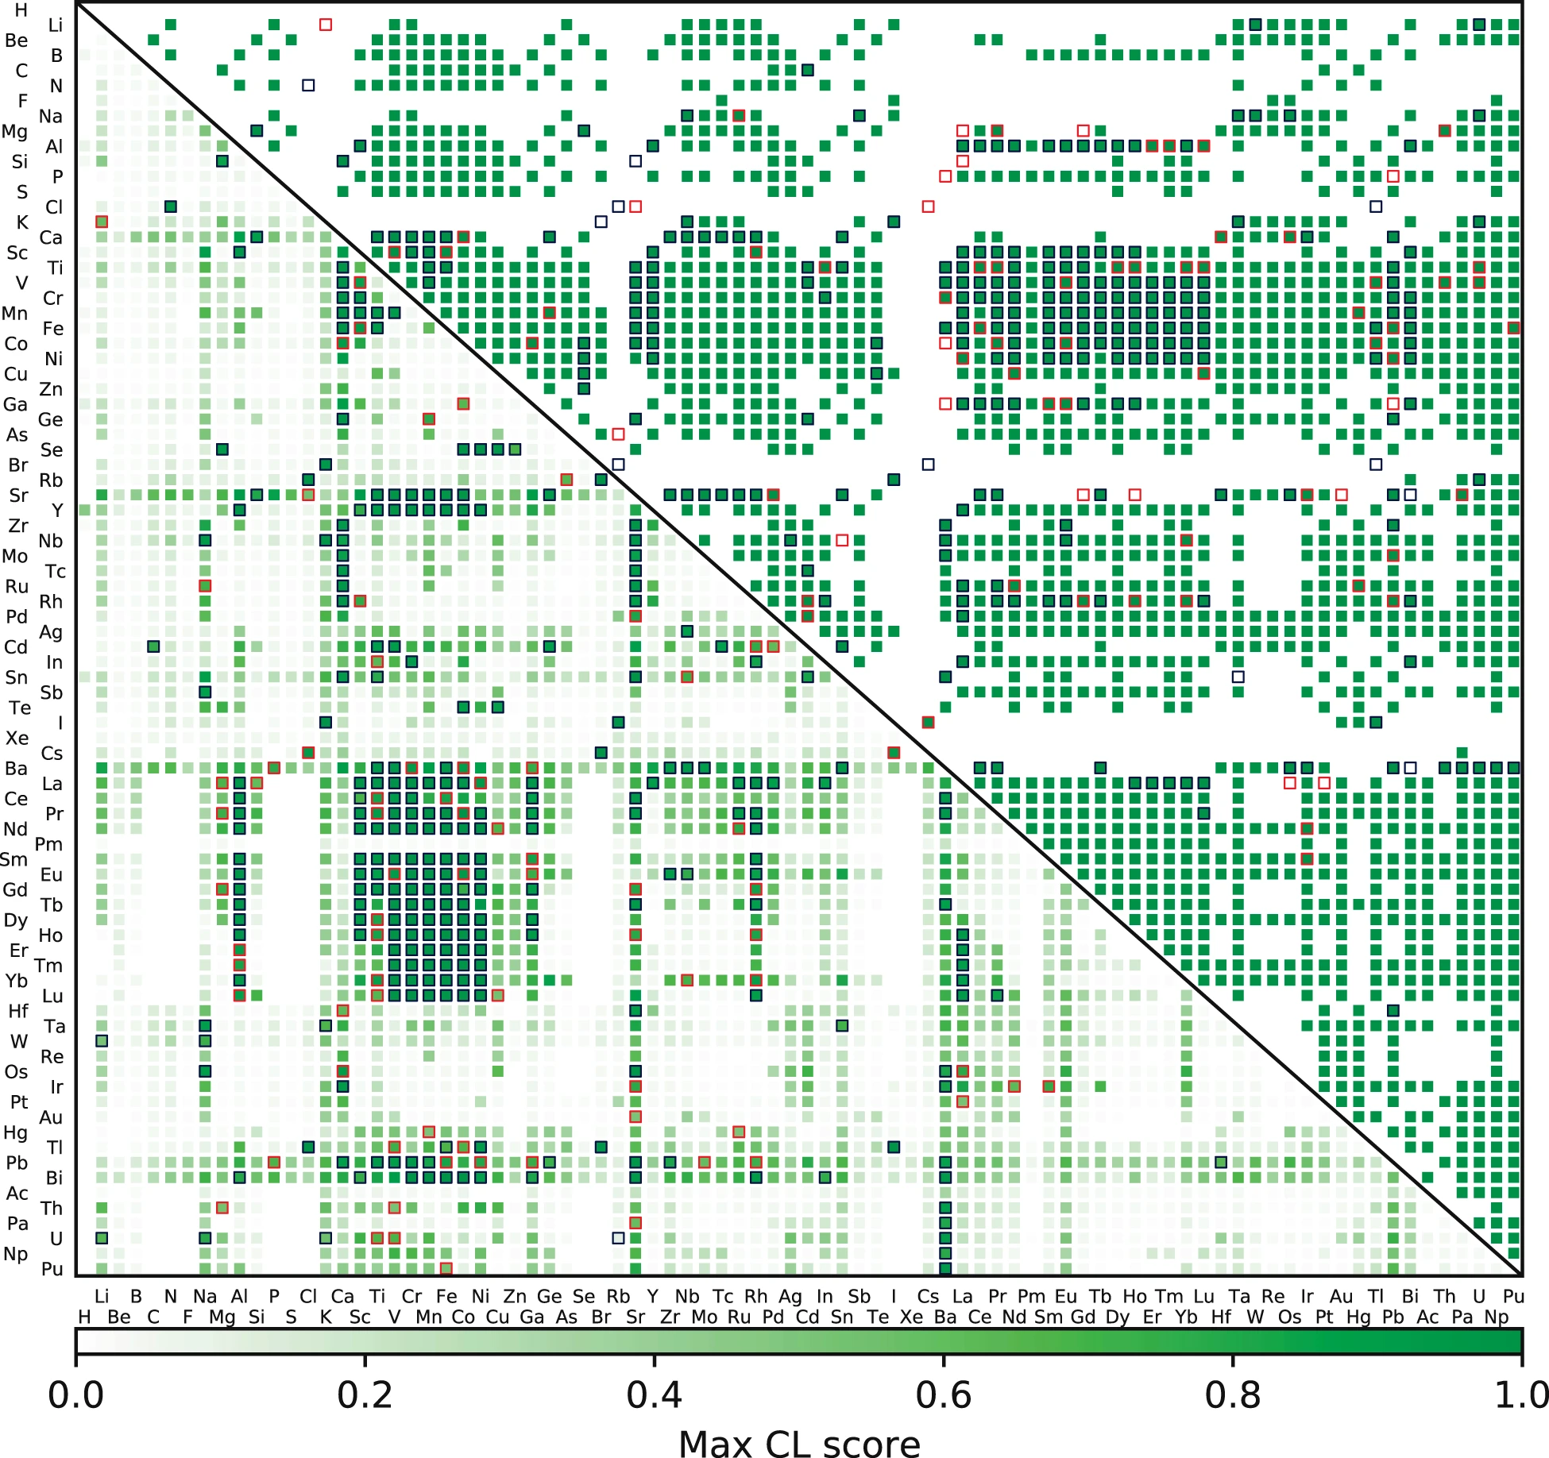
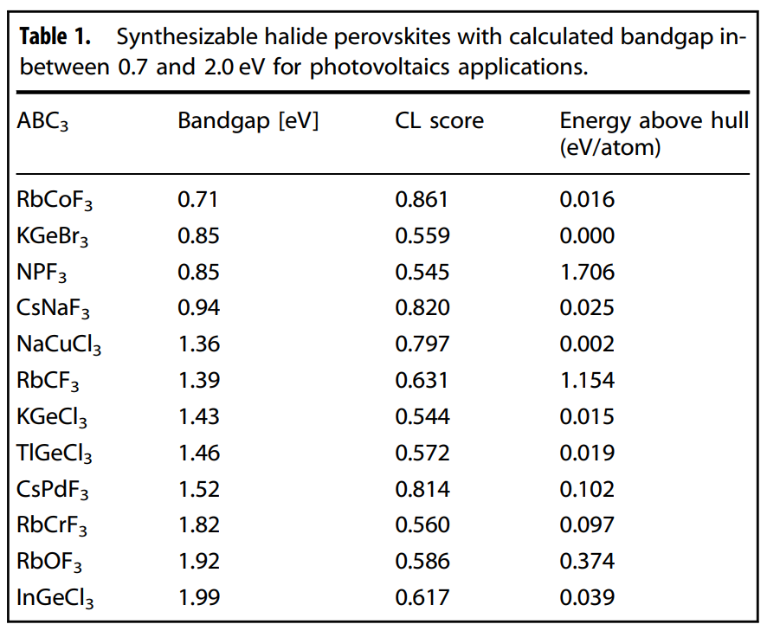
ABO₃ Perovskite Oxide Map
Discovery of New Halide Perovskite
New
Known

Slide 31
Flipped Learning
All lectures are pre-recorded and will be available a week prior.
Students will watch the lecture at home, solve problem sets before the class. Students are encouraged to work together!
Problem set is to be submitted online before the class. The effort and completeness will be graded.
During the class, students as many as the problems will be randomly selected to explain the solution to the class.
Students will get +1 point for presenting, -1 for absence, 0 for a pass or poor effort. These points will be the basis for the participation score. The accuracy of the solution is not graded.
All late assignments are accepted up to one week later at 50% credit.

Slide 32
Grades
Grades | Item | Description
35% | Problem set submission | To be submitted online before the class
35% | Participation | Presenting and explaining the solution of problem set
10% | Project proposal | 1 page summary of the project
20% | Project presentation | 15-minute presentation of the project
100% | Total

